Slide 1
Starfish Door Decoration
Submitted by: Carolina Broach
Resident Advisor
Saint Joseph's College of Maine

Slide 2
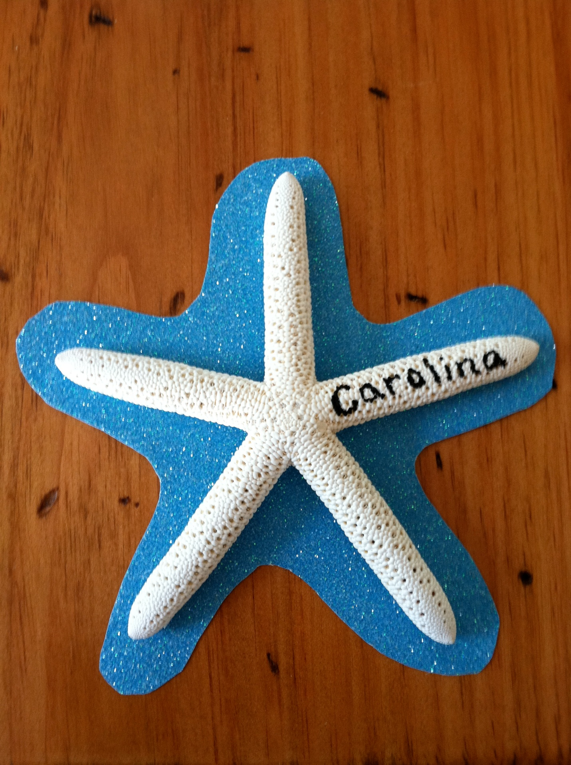
Starfish Door Decoration

Slide 3
How to make the Starfish Door Decoration
I made cute starfish door tags!
I went to a local store in my hometown which is right on the ocean and bought 25 starfish. I then went to target and got some glittery scrapbook paper to mount the starfish on. I got several different colors, pink, green, blue, and purple. I put each of their names on an arm of the starfish!
I used double stick tape to secure the starfish on the scrapbook paper and I used permanent markers to write the resident’s name on the starfish.
They came out super cute!
Submitted by: Carolina Broach, Resident Advisor, Saint Joseph's College of Maine

