Slide 1
Mustache Door Decorations
Jennifer Rose Gnerer
Community Advisor
Minnesota State University

Slide 2
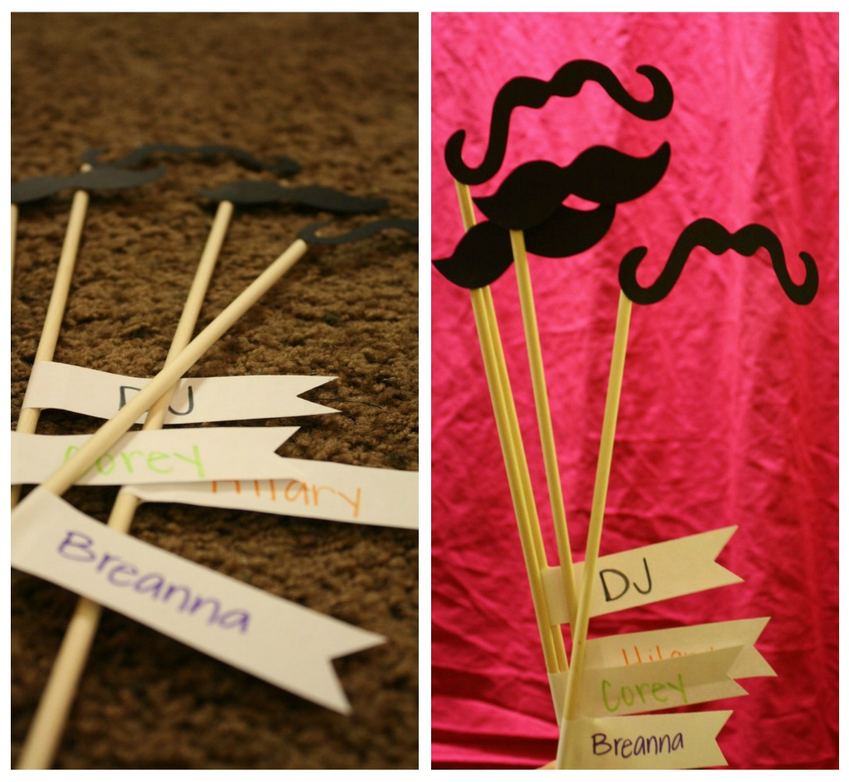
Mustache Door Decs!

Slide 3
Notes from mustache door dec creator
I made these door decs with skinny wooden dowels, mustache cutouts and strips of paper with the residents name on them. It's a super simple door dec and the residents can take them off their doors if they want to use them in some silly way.
My residents loved them!

