Slide 1
Halloween Variety &
Interactive Bulletin Board
Submitted by Amanda Poston, RA, Colorado State University

Slide 2
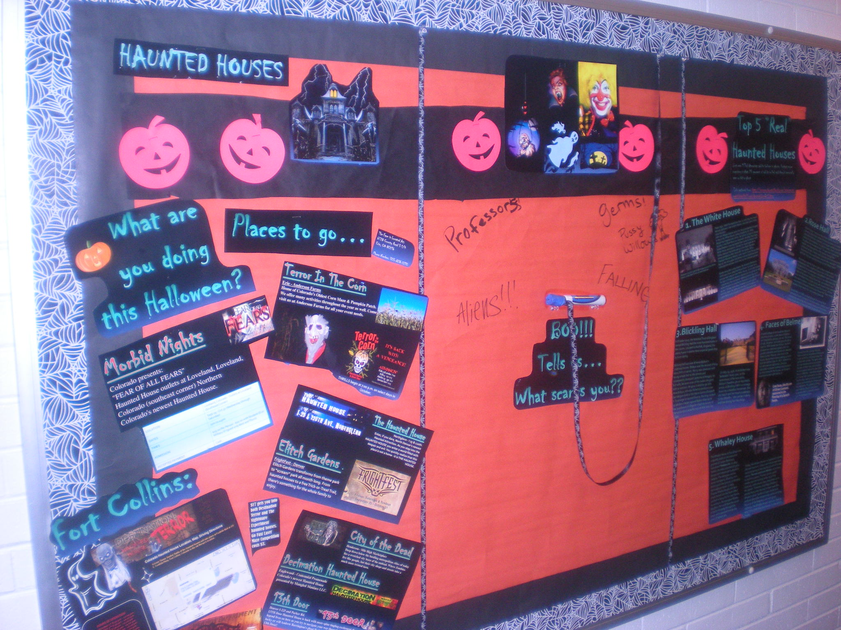

Slide 3
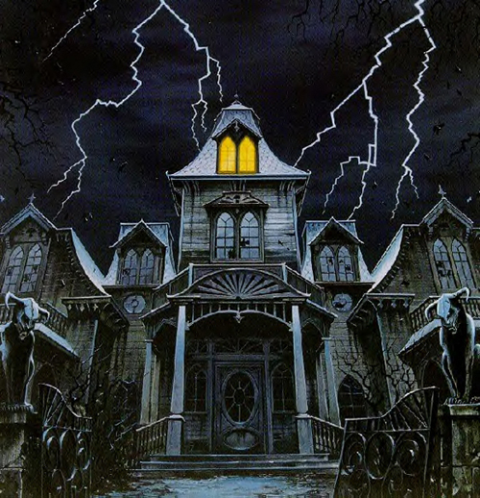
HAUNTED HOUSES

Slide 4
Top 5 “Real”
Haunted Houses

Slide 5
Just over 1/3 of American adults believe in ghosts. Perhaps more surprising is that 23 percent of adults polled said they'd personally seen or felt a ghost (Info gathered from: ttp://science.howstuffworks.com/science-vs-myth/afterlife/5-real-haunted-houses5.htm)

Slide 6
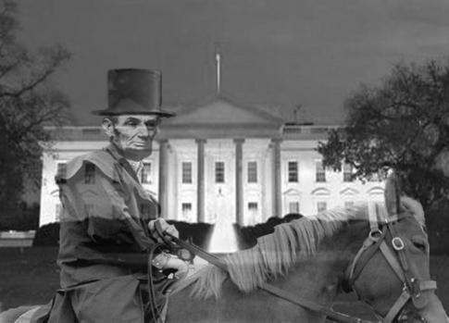
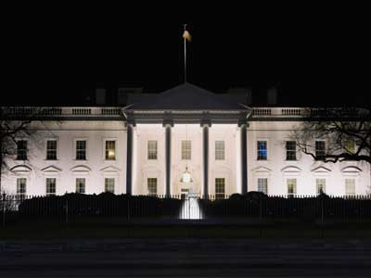
1. The White House
­
That's right: 1600 Pennsylvania Ave. is not only the most famous address in the United States, but also one of the most haunted.­
John and Abigail Adams were the first presidential couple to live in the White House, taking residence in 1800. Abigail has lingered ever since: Her ghost is said to hang laundry in the East Room on occasion. Another first lady, Dolley Madison, has reportedly been quite territorial with White House renovations. During her husband's term, Dolley oversaw the landscaping of the Rose Garden, where presidents often meet with the media. When President Woodrow Wilson's wife tried to have the garden dug up, the story goes that Dolley's ghost appeared and instructed the workers not to tear up her beloved garden.
Going along with a rose theme, the Queen's Bedroom, which was once called the Rose Room, is known as a paranormal hotspot in the White House. It not only houses the bed of President Andrew Jackson but his ghost as well -- people say they've heard it walking around the room. Jackson's ghost is rumored to hang out in the Red Room as well. People have seen Abraham Lincoln's ghost ambling down the halls and staring out of windows. He pays visits to the Lincoln bedroom at times as well.
Abraham Lincoln's ghost still hangs around the White House, particularly in the Lincoln bedroom.

Slide 7
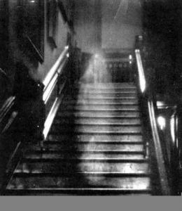
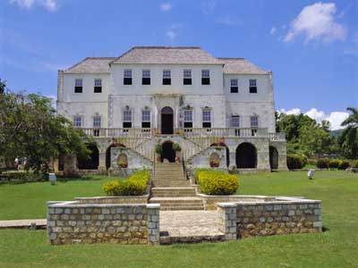
2.Rose Hall
Annie Palmer, known as the White Witch, lived in Jamaica's Rose Hall. When Palmer became sexually unsatisfied with her husband, she began sleeping with slaves on the plantation. In order to keep them quiet about the affairs she murdered them. To gain her husbands wealth, she poisoned him. Her sexual escapades continued as well. Palmer had a pit dug 16 feet below the house where she would banish anyone who wouldn’t sleep with her. She later became known as the White witch.
According to legend, Palmer cast a fatal voodoo hex on a housekeeper who caught the eye of one of her lovers. Supposedly, the housekeeper's grandfather later strangled Palmer to death. Her body was buried in an aboveground coffin in the eastern wing of Rose Hall. According to the lore, the White Witch's spirit, along with those of the slaves she had murdered, continued to haunt the house. When new tenants attempted to move into Rose Hall, they were quickly driven away from the haunted grounds.
Eventually, in 1965, a couple bought the house and converted it into a museum. Yet even today, visitors and employees have reported hearing men's screams and doors slamming, as well as other paranormal phenomena.

Slide 8
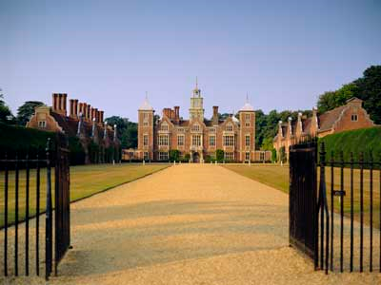
3.Blickling Hall
In October 2007, the National Trust of England named Blickling Hall the most haunted home in the country. Located in Norfolk, England, the stately house is said to have a special guest stop by every spring.
Blickling Hall was one of Anne Boleyn's childhood homes. Boleyn was the second of King Henry VIII's six wives. Henry was obsessed with having a male heir to the throne and consequently divorced Catherine of Aragon, his first wife, because none of the males she gave birth to survived. He gave it another go with Anne Boleyn, who also failed to produce a son (but did give birth to the future Queen Elizabeth I). To arrange his second divorce, the king cooked up adultery charges against Boleyn that stuck. Her punishment of allegedly cheating on one of the world's most powerful men at that time was death.
On May 19, 1536, Anne Boleyn was beheaded. Every year, on the anniversary of her execution, Boleyn's headless ghost reportedly arrives at Blickling Hall in a carriage drawn by a headless horseman. But she hasn't lost her head completely in the afterlife -- she carries it along with her during her hauntings.

Slide 9
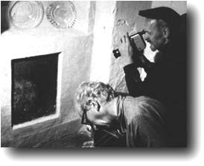
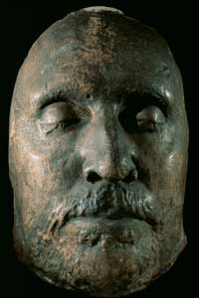
4. Faces of Belmez
A small cottage in the southern Spanish province of Jaen, in the town of Belméz, isn't haunted by ghosts, per se. The house is built, however, on burial grounds dating back to 1830.Inside the kitchen, the floor contains an unsolved mystery that has puzzled scientists and laymen for decades. Maria Goméz Pereira, who lived in the house, discovered a face peering up at her from her kitchen floor in 1971. Instead of a two-dimensional apparition, the face resembled a plaster casting that seemed to rise from beneath the house, as though a head was buried right below it.­­
Spooked by the strange façade, Pereira and her neighbors attempted to get rid of it by chipping away the cement with an axe. Yet upon doing so, they revealed more face casts, this time of older men and children. As word spread about the so-called "faces of Belméz," scientists stepped in to verify their authenticity and test whether they were paintings or fake castings orchestrated by Pereira and her neighbors. The painting theory was ruled out, but no conclusive evidence exists to pinpoint exactly how the faces got there.
Cast faces, like this one of Oliver Cromwell, appeared in the flooring of a Spanish home.

Slide 10
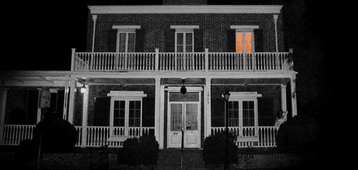
5. Whaley House
The Whaley House in San Diego was originally built on the execution grounds of Yankee Jim. In 1852, Yankee Jim was convicted of grand larceny and sentenced to death by hanging. The hangman set the noose improperly, allowing Jim's feet to graze the ground, prolonging the hanging process. In 1856, Thomas Whaley bought the land where Yankee Jim had been killed and built a house for his own family. According to the youngest Whaley daughter, she could hear the sound of boots clomping through the house and suspected it to be the ghost of Yankee Jim.
Today, the Whaley House is a registered historic site and museum. Visitors and employees have reported seeing or hearing the ghosts of former owners Thomas and Anna Whaley. According to staff and guests, Thomas' ghost usually resides near the landing at the top of the staircase, while Anna's stays downstairs or in the garden. Scents of cigar smoke and perfume have also mysteriously arisen at times. Because of the frequency of such ghost sightings, the Whaley House has been cited as one of the most haunted houses in the United States.

Slide 11
Places to go…
Things to do…

Slide 12
What are
you doing
this Halloween?

Slide 13
BOO!!!
Tells us…
What scares you??

Slide 14
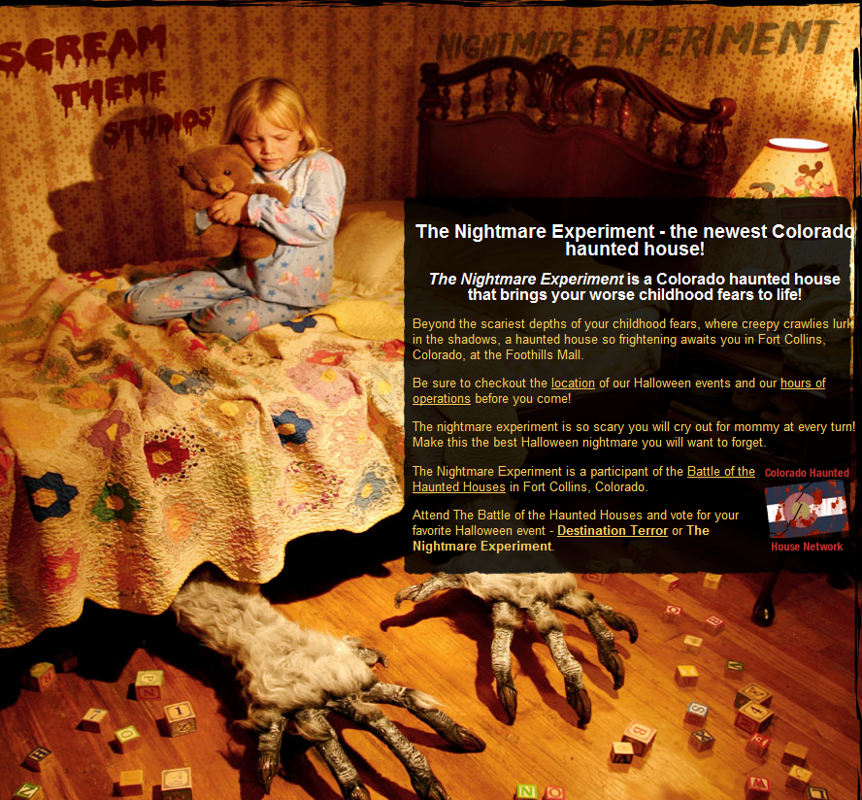
$17 gets you into both Destination Terror and The Nightmare Experiment haunted houses.
Go Fast Laser Maze Competition costs $3.

Slide 15
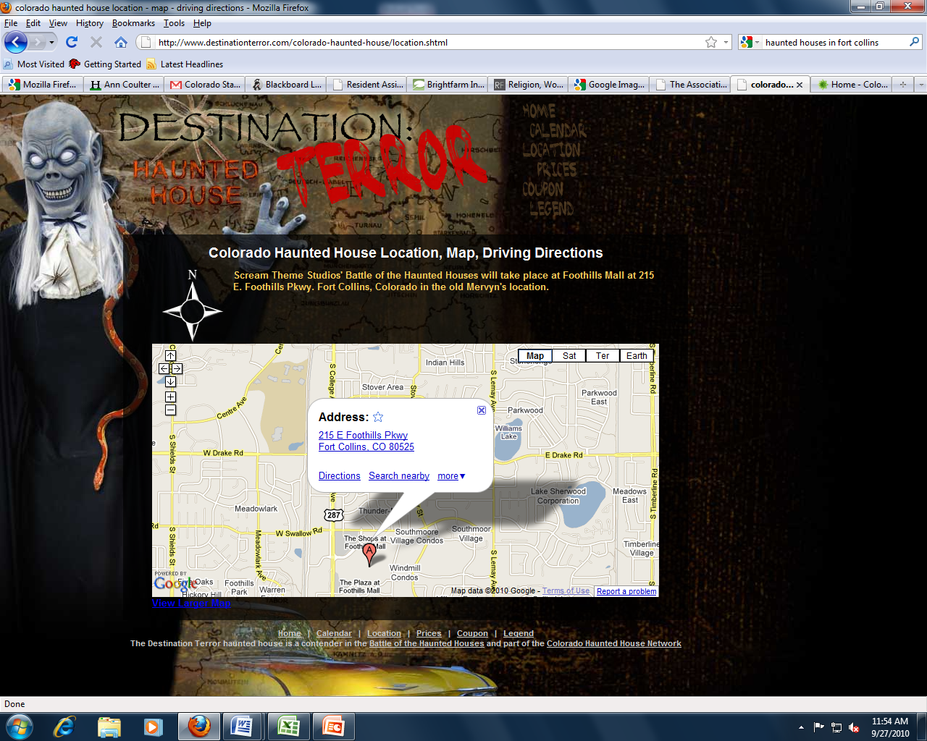
HOURS OF OPERATION
Friday October 1st 6:30 pm - 10:00 pm
Saturday Oct 2nd 6:30 pm - 10:00 pm
Friday Oct 8th 6:30 pm - 11:00 pm
Saturday Oct 9th 6:30 pm - 11:00 pm
Thursday Oct 14th 6:30 pm - 10:00 pm
Friday Oct 15th 6:30 pm - 11:00 pm
Saturday Oct 16th 6:30 pm - 11:00 pm
Thursday Oct 21st 6:30 pm - 10:00 pm
Friday Oct 22nd 6:30 pm - 11:00 pm
Saturday Oct 23rd 6:30 pm - 11:00 pm
Thursday Oct 28th 6:30 pm - 10:00 pm
Friday Oct 29th 6:30 pm - 11:00 pm
Saturday Oct 30th 6:30 pm - 11:00 pm
Sunday Oct 31st 5:00 pm - 10:00 pm

Slide 16
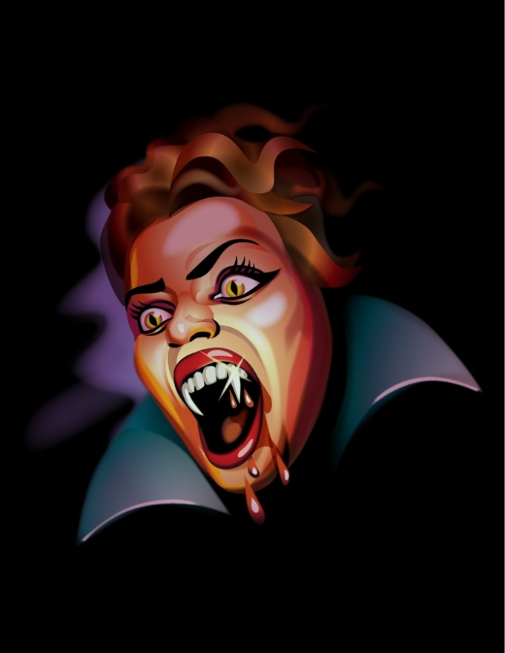
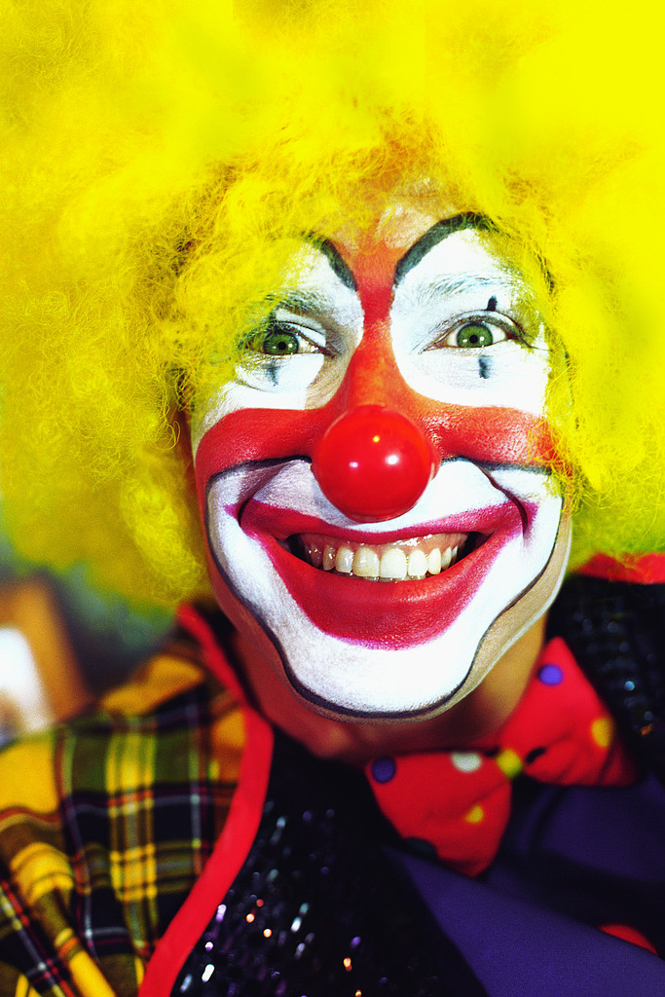
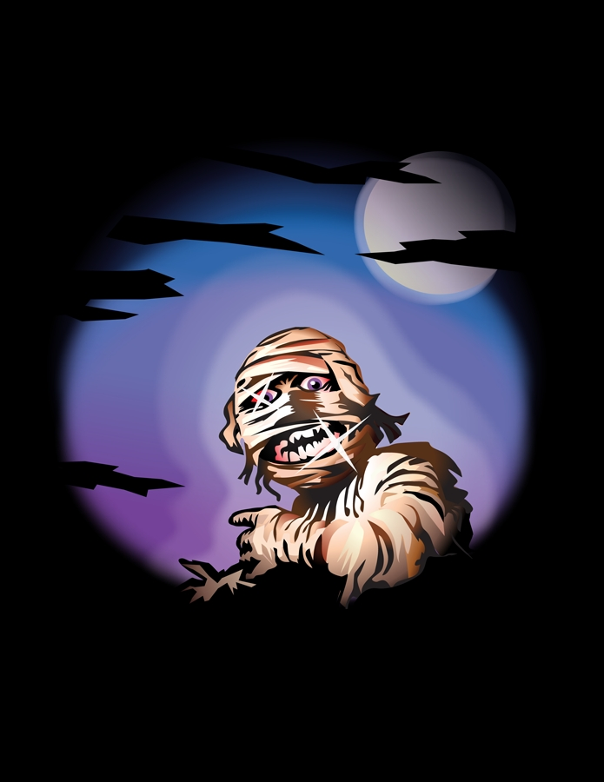

Slide 17



Curse of : Slaughterhouse Gulch
Aurora - I-225 and Parker Rd
Mike Myers, Jason and Freddy are just a few of the souls cursed to haunt Slaughterhouse Gulch. Sweeney Todd will give you a close shave and Hannibal is hungry for your company and Leather Face is ready to start the massacre. They know what you did last summer, but will you survive this fall at Slaughterhouse Gulch?
Haunted Mansion
Littleton - 5663 So Prince Street.
A Colorado tradition. This Haunted House has been in business for over 36 years. Haunted Mansion features cutting-edge special effects and animatronics. There are over 30 rooms of Hollywood-style sets created by seasoned professionals.

Slide 18



City of the Dead
Henderson - Mile High Marketplace
Deep down below the bustling metropolitan cities of today lies a wretched city born of the undead. Where Zombies live like people, but their city shops and streets take a much more twisted turn.
Decimation Haunted House
Englewood - Centennial Promenade
Colorado's newest Haunted House
presented by Mangled Maniacs LLC.
13th Door
Denver I-225 and Parker Rd.
13TH Door Haunted House is back with more spine tingling excitement than ever before. The legend lives on here as you try to navigate your way through the Barrington Hotel. Will you be as lucky or will Andrew Barrington's ghost find you first! Your only hope of survival is to find the 13th Door!

Slide 19


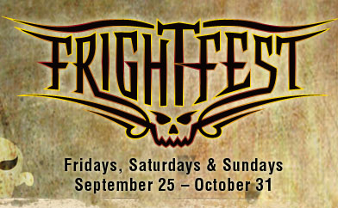
The Haunted House
Northglenn - I 25 & 120th.
Enter, if you dare, North Denver's newest Haunted Attraction. As you step into the HAUNTED HOUSE you enter a world filled with despair and evil. You quickly realize that this place is not a home - it is THE HAUNTED HOUSE.
Elitch Gardens - FrightFest - Denver
Elitch Gardens transforms from theme park to “scream” park all month long. From haunted houses to a free Trick-or-Treat Trail, there’s something for the whole family to enjoy.

Slide 20
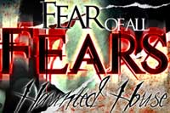
Morbid Nights
Colorado presents:
"FEAR OF ALL FEARS"
Haunted House outlets at Loveland, Loveland, Colorado (southeast corner) Northern Colorado's newest Haunted House.
LOCATION | Loveland, Colorado - Outlets at Loveland (Southeast Corner)
DATES | Sept 29 - Oct 31 (Wednesday through Saturday)
TIMES | 7pm to 11pm
ADMISSION | $15.00 Per Person - $10.00 with Student ID or Military ID (good only Wed and Thurs)
ACCEPTED PAYMENT | Cash

Slide 21

I SCREAM FACTORY
HAUNTED HOUSE
I Scream! You Scream! WE ALL SCREAM! Welcome to the I SCREAM FACTORY! Denver's newest and scariest Haunted House. This ain't NO amusement park! Complete with everything you would expect from your worst nightmare.
LOCATION | 3280 Brighton Blvd. Denver, CO 80216 - I-70 and Brighton Blvd. Exit 275B
DATES | Oct 01 - Oct 31 (Closed 4-7 and 11-14)
TIMES | Mayhem starts at 7:00
ADMISSION | $18.00 General Admission - $26.00 VIP
PAYMENT | CASH, Visa, MC, Discover, Amex
PHONE | (720)775-7316

Slide 22

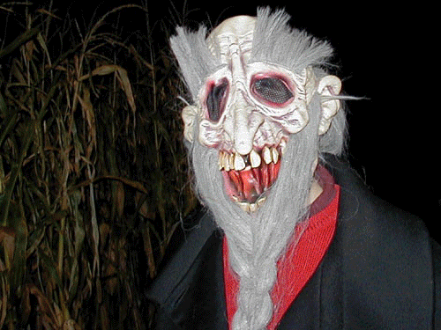

Terror In The Corn
Erie - Anderson Farms
Home of Colorado's Oldest Corn Maze & Pumpkin Patch. We offer many activities throughout the year as well. Come visit us at Anderson Farms for all your event needs.
The Farm is Located At:
6728 County Road 3 1/4
Erie, CO 80516
Phone Number: 303-828-5210
THRILLS begin at 7:00 p.m. on select days in October.

Slide 23
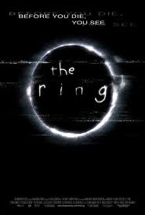
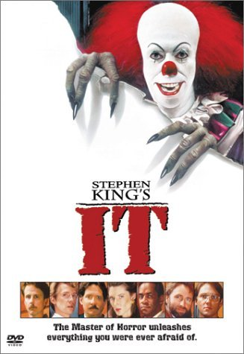

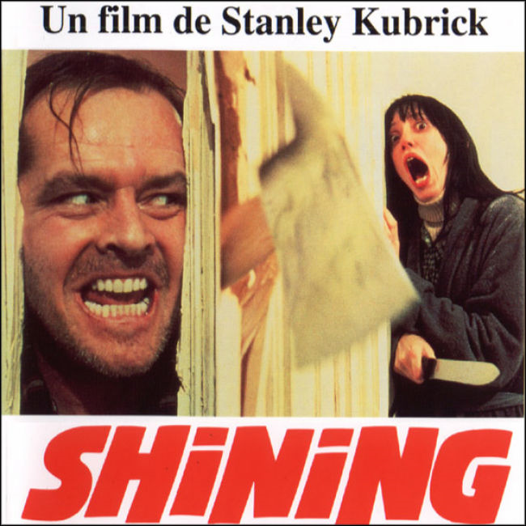
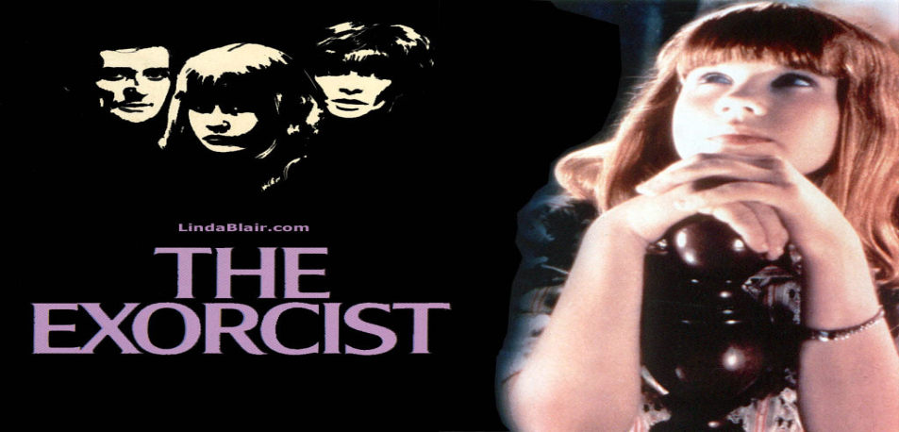
MUST SEE HORROR
MOVIES.

Slide 24
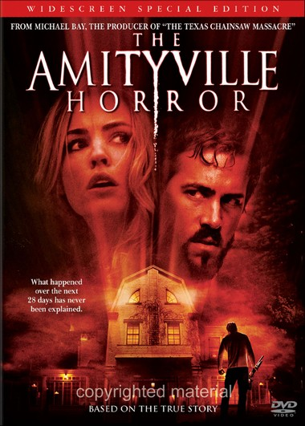

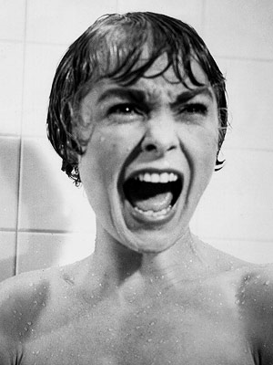
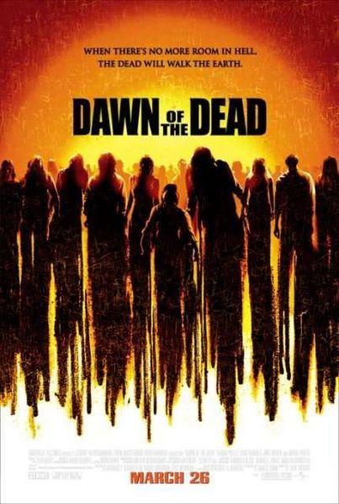
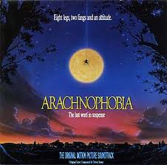
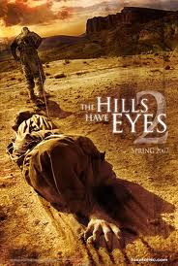
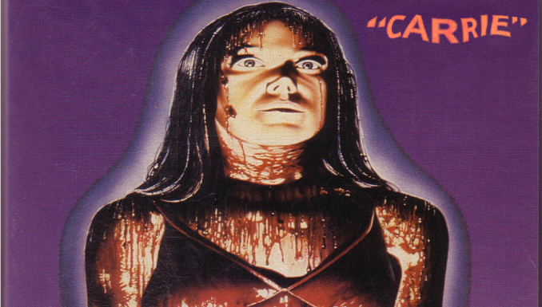

Slide 25
