Slide 1
Egg Hunt
Lock Haven Staff
Lock Haven University
Pennsylvania
Featured Institution
Submitted by Wendy Walsh, Student Life Coordinator

Slide 2
Description of Egg Hunt
A local kindergarten and/or first grade class are invited to join the resident students to participate in the children’s Egg Hunt.

Slide 3
Description of Egg Hunt
The children are invited to take a bag to use to collect the eggs. Before they fill it with the eggs, they join the resident students and staff to enjoy simple delicious treats as they color and decorate their bags. The staff and resident students hide the eggs all over the complex. At a set time, the children are guided to the area where the eggs are located and are told to “start the hunt for the eggs!” Staff /college students are buddied up with children to ensure every child is safely succeeding with the collection of eggs!

Slide 4
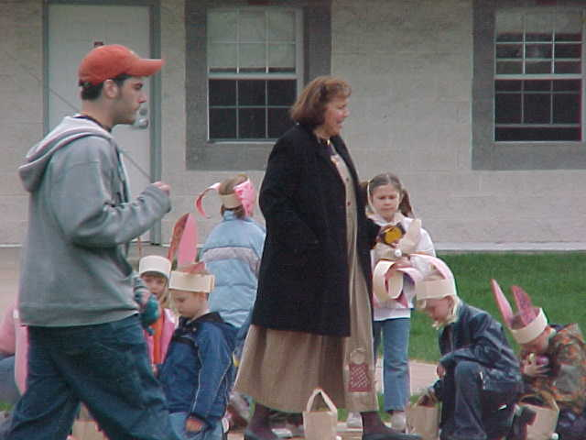

Slide 5
