Slide 1
Earth Day/Earth Month Interactive Bulletin Board
Candice Lawton Resident Assistant University of Tennessee Knoxville

Slide 2
Comments from the author
The pictures are of my "Earth Day/Earth Month" bulletin board. It's an "interactive" bulletin board in which residents can write ways they are "lending a hand in the preservation of Earth" (hence the hands around the world), or they can explain "what kind of footprint they are leaving on the Earth" (hence the feet). The little boxes around the world have tips on how to live sustainably (taken from a powerpoint on your site). I put it up yesterday and several people have already written things, so I think it's going to be a great success!

Slide 3
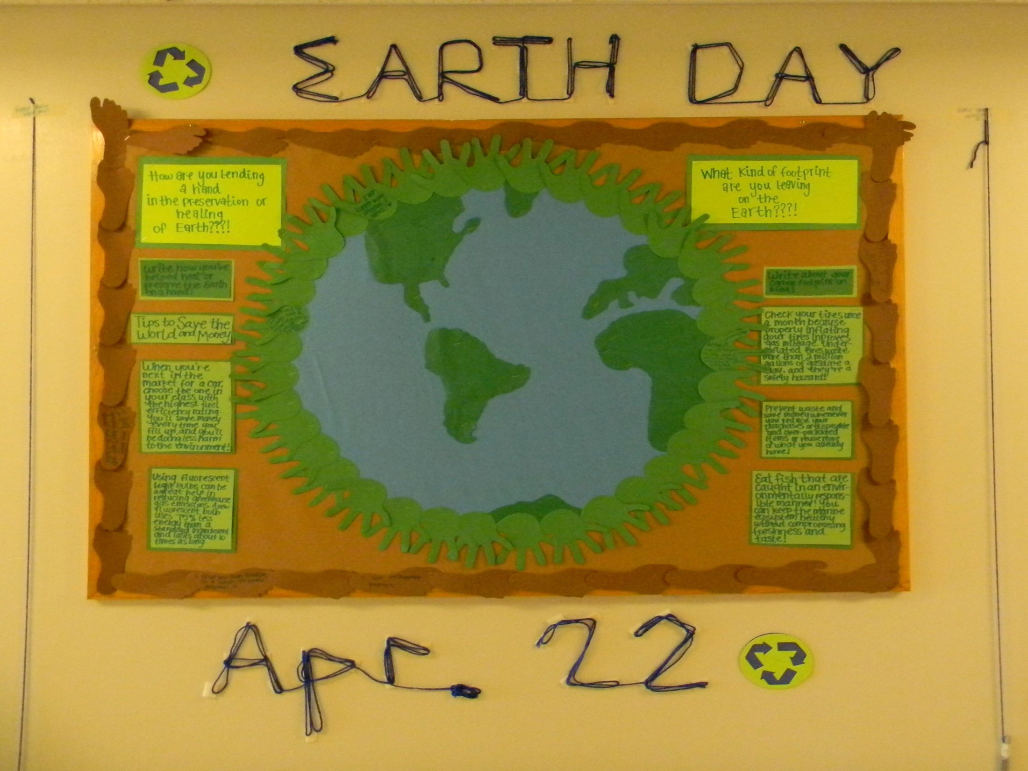

Slide 4
