Slide 1
Duck Pond Bulletin Board
Amanda Drew
Resident Assistant
Anna Maria College

Slide 2
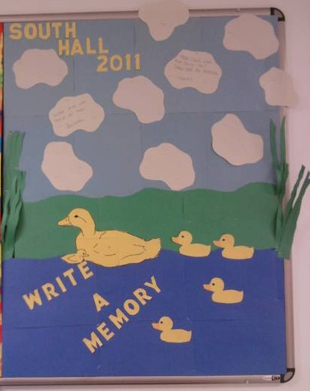

Slide 3
Bulletin board idea for the conclusion of a school year
The duck pond bulletin board was done for my residents at the end of the year. I was working in a small hall where the residents were really close and had built so many different memories together. The duck pond bulletin board was a way that they could all write down their favorite memories of the year.

Slide 4
Construction details
I used pieces of green construction paper to look like a grass boarder around the edge of the board. The water, grass, sky and ducks were created on the board with blue, green, light blue, and yellow paper. Letters were cut out in yellow construction with the name of our hall, the year, and an invitation for residents to share their favorite memories of the year. Clouds, made of white paper, were added to the sky in white paper. Residents wrote memories of the year on the clouds.

