Slide 1
Girly Door Decs:
pink, orange, yellow & rhinestones
Submitted by Ashley Sroufe Senior Resident Assistant at Xavier University Cincinnati, Ohio

Slide 2
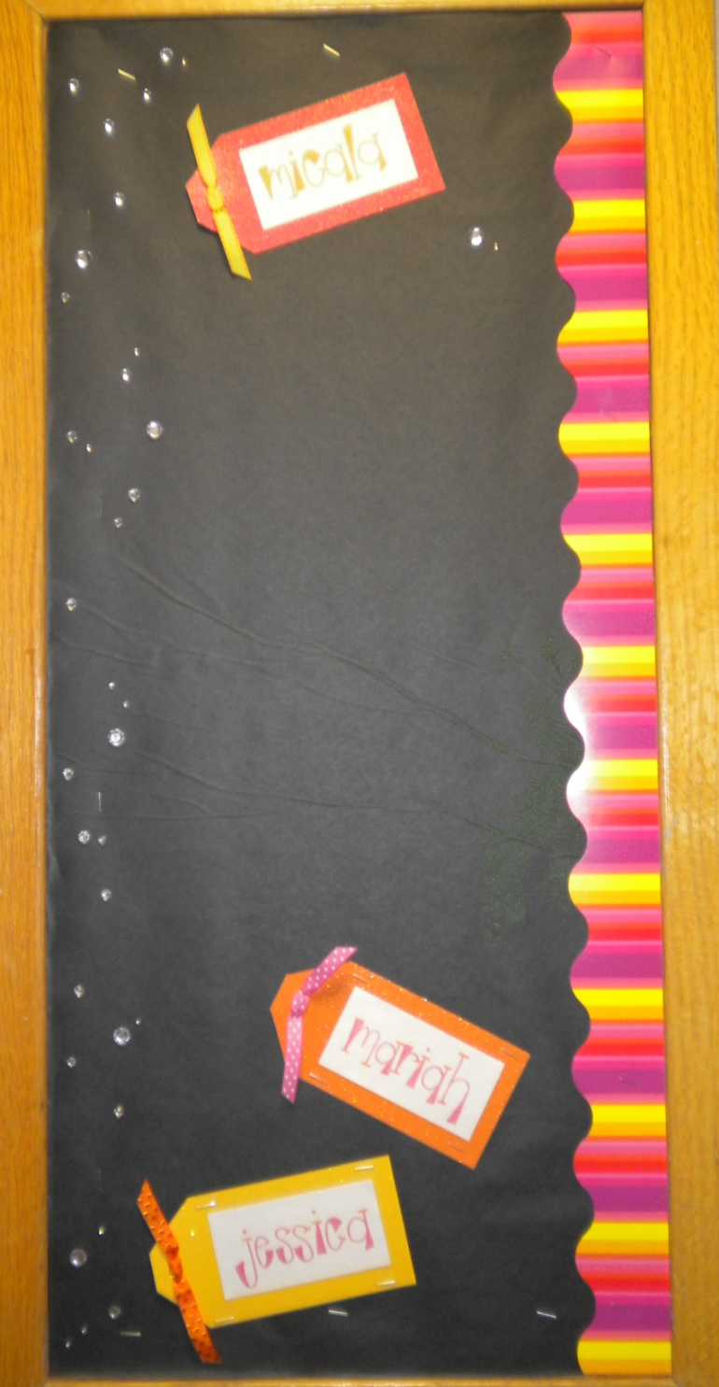

Slide 3
MATERIALS NEEDED: sparkly paper
stick on rhinestones
colorful sharpies .5” ribbon
border
(all purchased at Michael’s craft store)

