Slide 1
Ideas worth spreading
Have an hour to kill? Want to be a smarter person?
Original by: Blake Rottschafer
Updated by: Erin Ott and Devin Sloan

Slide 2
TED: Spreading Ideas.
TED's core value is spreading the idea of change.Their goal is to affect the minds of people in order to change the world. TED features speakers who are experts in their fields to discuss what they are passionate about. These "TEDtalks" are recorded and placed on TED.com for free, in order to inspire everyone.

Slide 3
TED.com
TED.com is broken up into a number of themes, so that related ideas appear next to the video being viewed.
These themes range from serious topics, such as medical innovations and green technology to light hearted topics such as comedy and music.

Slide 4
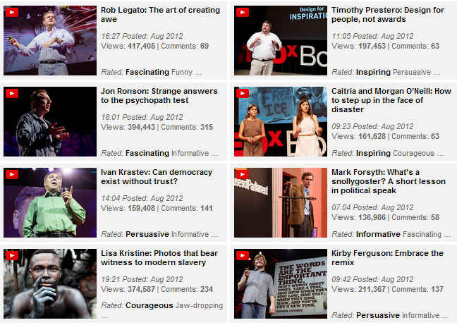
TED adds content weekly and is a constant source of new information.

Slide 5
Speakers
Through the years TED has featured many notable speakers, including:
Jeff Bezos- Amazon CEO
Bono- Musician
Sergey Brin- Google founder
Bill Clinton- Former President
Bill Gates- Microsoft founder
Imogen Heap- Musician
Stephen Hawking- Astrophysicist

Slide 6
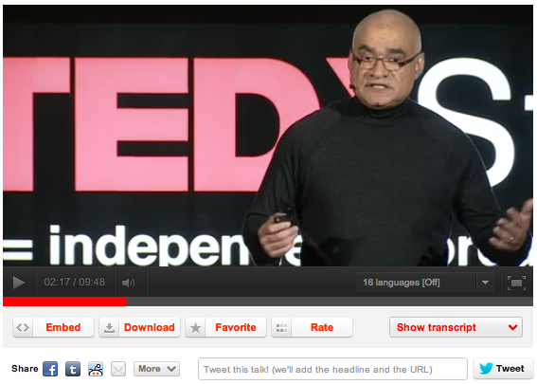
SHARE
TEDtalks are free and designed to be shared. If you see something interesting that really resonates with you, share it on Facebook or Twitter!

Slide 7
TED has thousands of ideas for you to use in a research project, or to...
GO CHANGE THE WORLD

