Slide 1
90’s theme: Rugrats Submitted by Galicia Guerrero Saint Mary’s College Theme – 90’s The Rugrats

Slide 2
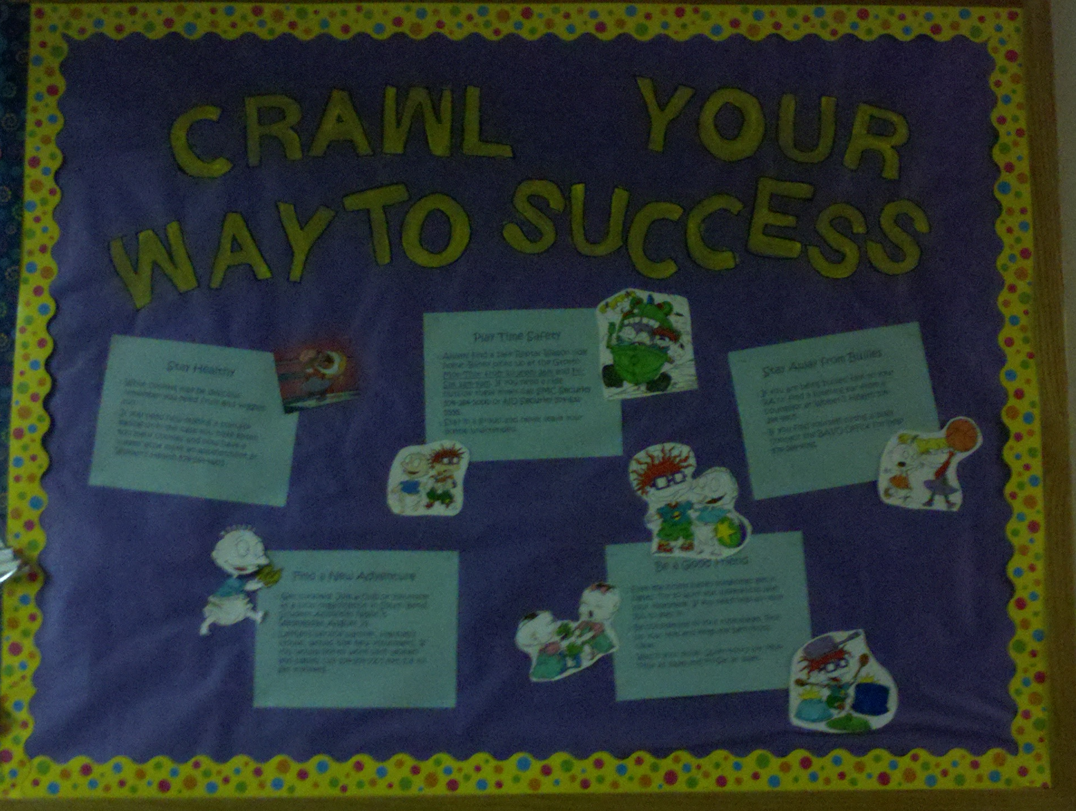

Slide 3
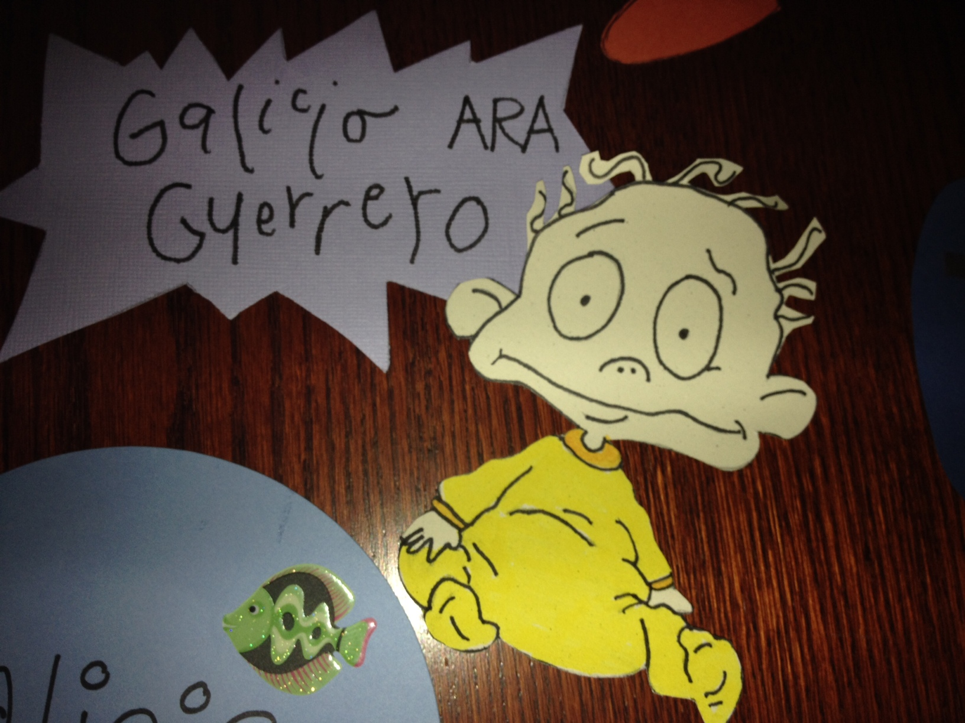

Slide 4
Information on Bulletin Board…

Slide 5
Play Time Safety
Always find a safe Reptar Wagon ride home. Blinky picks up at the Grotto Mon-Thur from 10:30pm-2am and Fri-Sat 2am-4am. If you need a ride outside these times call SMC Security 574-284-5000 or ND Security 574-631-5555.
Stay in a group and never leave your bottle unattended.

Slide 6
Be a Good Friend
Even the nicest babies sometimes get in fights. Try to work out differences with your roommate. If you need help ask your RA to step in.
Be considerate to your roommates. Pick up your toys and keep the bathrooms clean.
Watch your noise. Quiet hours are Mon-Thur at 10pm and Fri-Sat at 12am.

Slide 7
Stay Away from Bullies
If you are being bullied talk to your RA or find a listening ear from a counselor at Women’s Health 574-284-4805.
If you find yourself dating a bully contact the BAVO Office for help 574-284-4081.

Slide 8
Find a New Adventure
Get involved! Join a club or volunteer at a local organization in South Bend. Student Activities Night is Wednesday, August 29.
LeMan’s service partner, Hannah’s House, would love new volunteers. If you would like to work with women and babies call 574-254-7271 ext.114 to get involved.

Slide 9
Stay Healthy
While cookies may be delicious remember you need fruit and veggies too.
If you need help making a plan for eating or in the case you have eaten too many cookies and now have a tummy ache make an appointment at Women’s Health 574-284-4805.

Slide 10
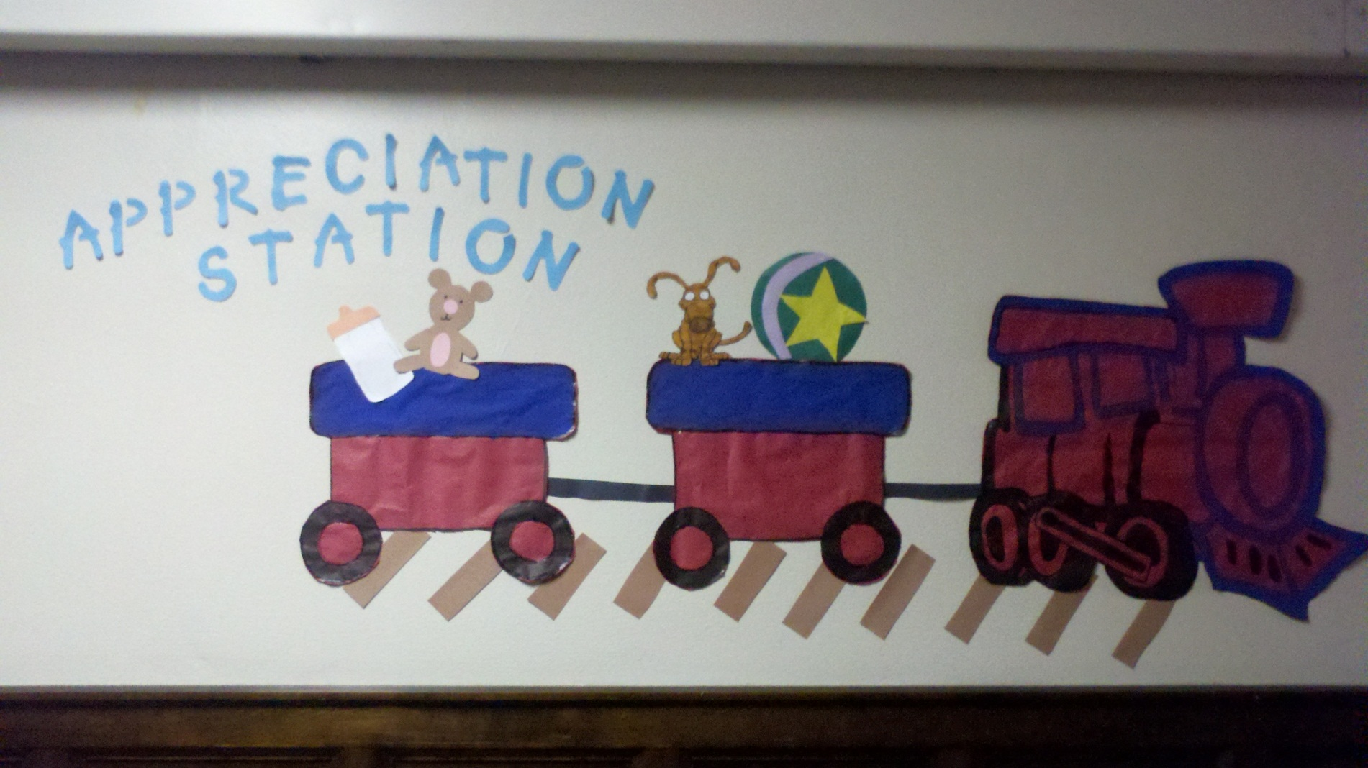
Optional Area for Highlighting Student Achievements

Slide 11
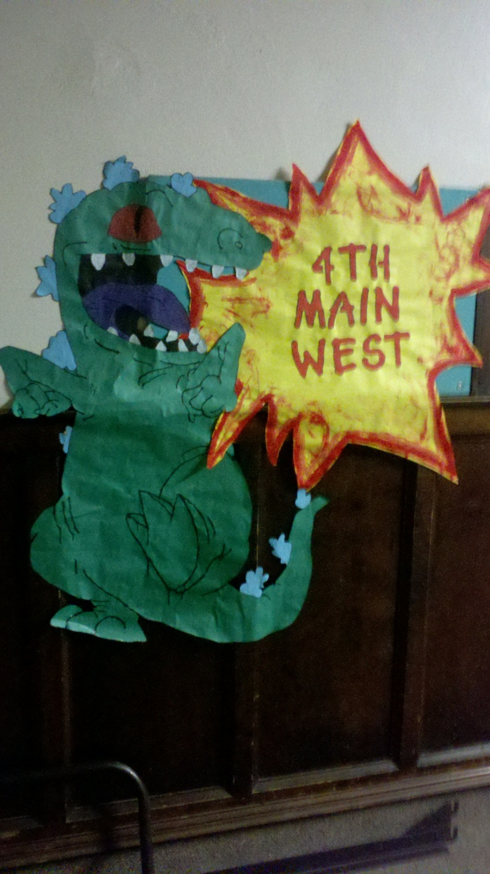
Extra Hall Décor to go with Theme

